Slide 1
Adding and Subtracting Integers
Ms. Latham

Slide 2

Review
Negative
Positive

Slide 3


24
7
30
Date
Adding and Subtracting Integers
EQ – How do we add and subtract integers?
Subtraction
Addition
Which direction do we go?
Subtraction we go left!
Addition we go right!
Positive integers
5 + 2
5 - 2
Start at 5 and go to the right 2
Get to 7
Start at 5 and go to the left 2
Get to 3
Notes:
Ask student to write questions for the notes.
Model Chunking of notes.

Slide 4
24
7
30
Date
Adding and Subtracting Integers
EQ – How do we add and subtract integers?
Subtraction
Addition
Think of negative numbers as the same as subtracting the number
What about adding negative numbers?
5 + -2
-2 + -2
Start at 5
+ means we are heading
But we are not adding a normal positive number. It is -2 so we turn around and go the opposite way.
What do we do for this one??
Notes:
Ask student to write questions for the notes.
Model Chunking of notes.

Slide 5
24
7
30
Date
Adding and Subtracting Integers
EQ – How do we add and subtract integers?
Subtraction
Addition
What about subtracting with negative numbers?
-3 - -2=
Start at -3 and……
4 - -3=
Notes:
Ask student to write questions for the notes.
Model Chunking of notes.

Slide 6
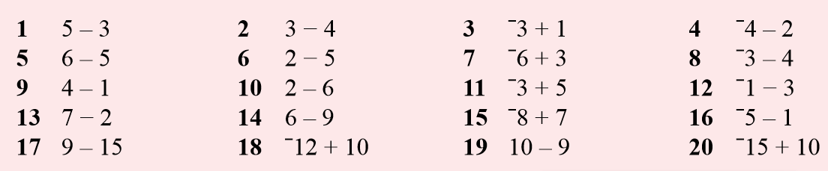
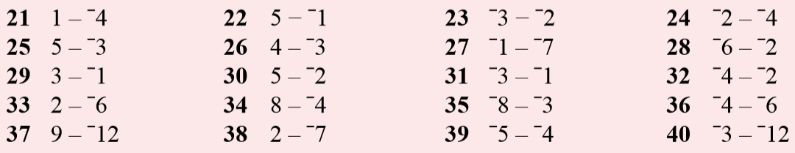
Beginner – pick 4 from each section
Intermediate – pick 8 from each
Advanced – do all of them!
Task Side Practice (use your number line!)

Slide 7
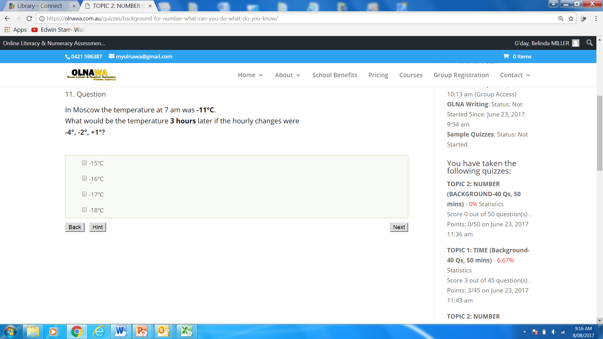

Slide 8
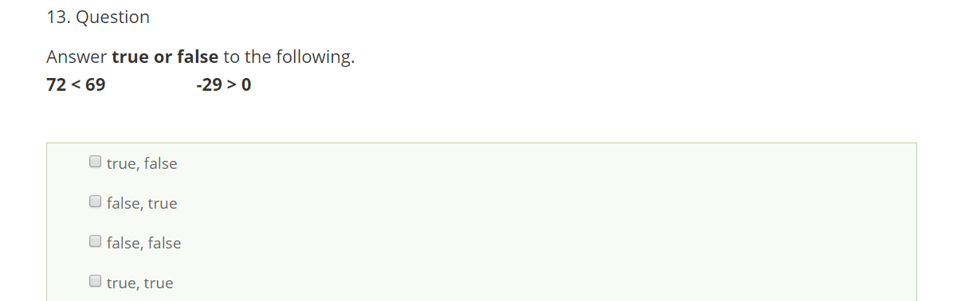

Slide 9
